Slide 1
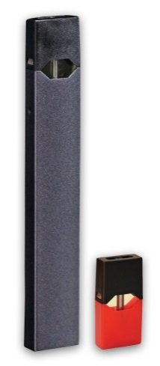
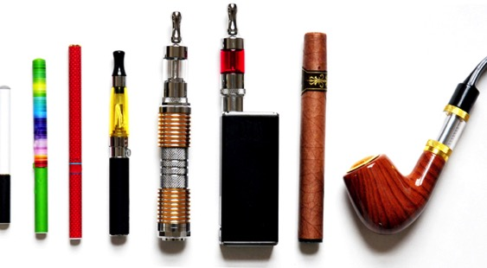
E-cigarettes and Youth
Get the Facts!
Notes:
Speaking Notes:
This morning we are going to have a discussion about vaping (also known as e-cigarettes)
We will review:
What vapes are and how they work
What they look like
What’s in vapes and vaping products
And what the concerns are about youth using e-cigarettes or vaping
To make this a little more interactive and fun…we are going to play a game called “Fact or Fiction” …
I’ll give you a statement about vapes and we’ll decide on whether that statement is fact or fiction
And then we’ll talk about why

Slide 2
Disclaimer
This presentation was developed prior to October, 2019 and because the vaping landscape is shifting and changing rapidly/daily some of the information in the presentation may already need updating so that it is current and accurate for today. Please reach out to The NL Alliance for the Control of Tobacco to discuss before quoting from this presentation.
NL Alliance for the Control of Tobacco (ACT)
709-753-0079
melissamoore@actnf.com

Slide 3
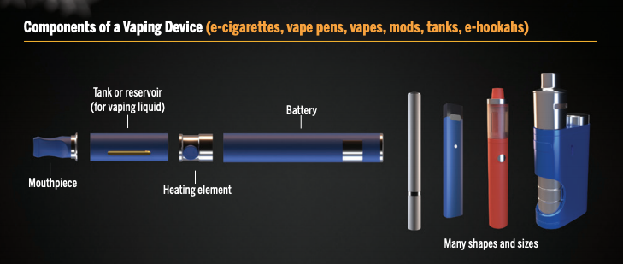
What is an e-cigarette or vaping device?
Components of a Vaping Device (Source: Health Canada)
Notes:
Speaking Notes:
Let’s start by reviewing what an e-cigarette is and how it works….
E-cigarettes go by a number of names – e-cigs, vapes, vaping devices, vape pens, JUUL to name a few.
Essentially, these devices heat a liquid to create an aerosol or vapor. The act of using an e-cigarette to create this aerosol is called vaping.
Extra Notes for the Teacher:
This section is Intended to provide teachers with additional background for their own knowledge or in some cases to provide further detail to the class – especially for classes in higher grades)
JUUL is actually a brand of e-cig that has become so popular with youth, that sometimes e-cigs are referred to as JUUL and vaping is known as JUULing)
More detail on how they work:
Vapes are devices that use a BATTERY to heat a COIL/HEATING ELEMENT
The hot COIL heats up a LIQUID (called e-liquid or e-juice or vaping liquid )
(The liquid is contained in a TANK or POD; some e-cigs are disposable and come with pre-filled e-liquid; some contain tanks that you refill yourself; some use a pod containing e-liquid that you snap in to the device)
The heated liquid turns into an AEROSOL or VAPOR
The aerosol in inhaled through a MOUTHPIECE into the lungs and exhaled as a vapor cloud

Slide 4
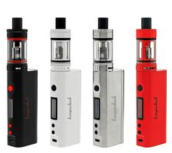
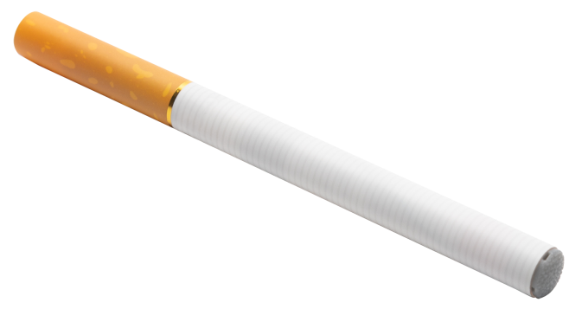
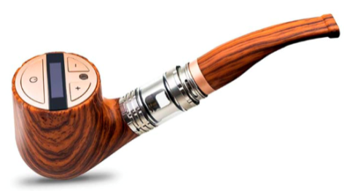
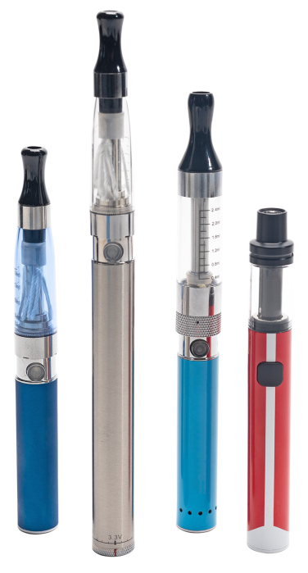
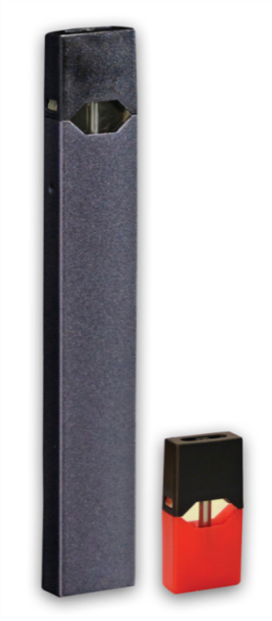
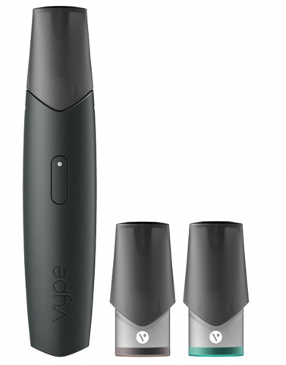
What do e-cigarettes look like?
Cig-a-like
Box-mod
Pipe
Pods
Vape pen
Notes:
Speaking Notes:
E-cigarettes are available in lots of different shapes, sizes and colours, sometimes making them more difficult to recognize
They can look like cigarettes, pens, juice boxes or even flash Drives.
Extra Notes for the Teacher:
Some look like cigarettes (called Cig-a-likes) or pipes (called e-pipes)
Some look like Pens (called Vape Pens)
Some look like a box with a straw (called Box mods)
Some look like a USB stick (called Pods)…Common pod-type vapes are VYPE and JUUL – both are depicted in this slide (lower right hand corner). They look like USB sticks. They use pods which contain the vaping liquid or e-juice. The pods snap into the top of the device. These are the most popular products with youth.

Slide 5
FACT or FICTION?
“Some e-cigarettes are safe for youth.”
Notes:
Speaking Notes:
Okay, It’s time to play FACT or FICTION…
I will give you a statement and you tell me if it’s Fact (if its True) or FICTION (if it’s false)
Here’s the first one….what do you think, is this statement fact or fiction…
Extra Notes for the Teacher:
Suggest you poll class opinion by asking for a show of hands for fact then a show of hands for fiction…(and maybe show of hands for don’t know)

Slide 6

Notes:
Speaking Notes:
Let’s hold off on the answer to this one for now…
Maybe we need to find out a bit more about what is fact and what is fiction when it comes to youth and vaping before we decide.
Let’s come back to this a bit later…
Extra Notes for the TEACHER: Perhaps you can start this by summarizing the preliminary class poll results from the previous slide …e.g. looks like most of the class thinks they are not safe or looks like we are split 50:50 or I didn’t see a lot of hands go up…maybe folks are unsure…etc.

Slide 7
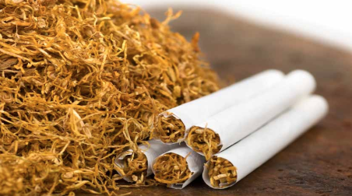
FACT or FICTION?
“ E-cigarettes contain tobacco.”
Notes:
Speaking Notes:
Here comes another…
E-cigarettes contain tobacco…is that fact or is it fiction…what do you think?

Slide 8
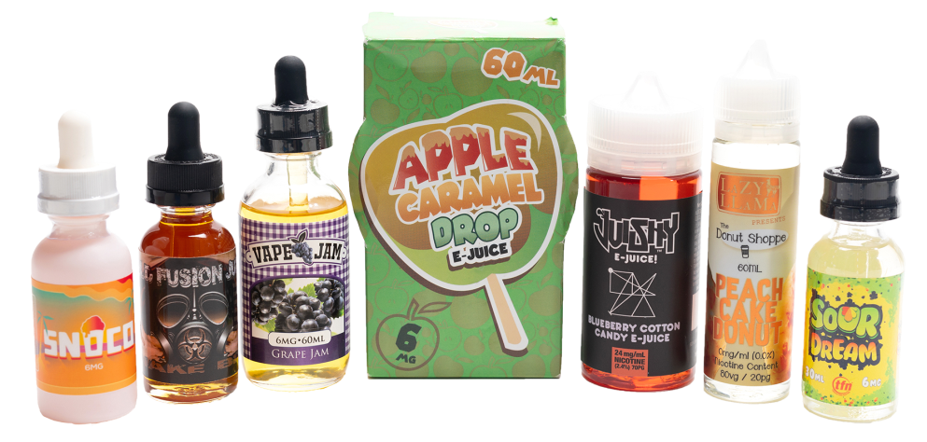
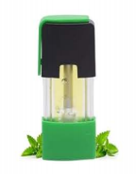
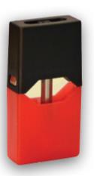
FICTION
E-cigarettes do NOT contain tobacco
They contain a liquid called “e-liquid” or “e-juice”
Some come with the liquid already in them. For others you have to add it.
This liquid can come in a variety of flavours including a tobacco flavor, but fruit and candy flavours are the most popular
Notes:
Speaking Notes:
It’s FICTION.
Regular cigarettes contain tobacco, but E-cigarettes do not.
E-Cigarettes heat up a liquid instead of burning tobacco like regular cigarettes
The liquid is sometimes called e-liquid or vaping liquid, or more commonly e-juice
Although this liquid does not contain tobacco, it can be flavoured to taste like tobacco
So let’s explore what is actually in that e-liquid …next slide

Slide 9
FACT or FICTION?
“The aerosol or vapor from an e-cigarette
is just harmless water vapor.”
Notes:
Speaking Notes:
Ok so is the following statement fact or fiction…

Slide 10
FICTION
That aerosol or vapor is NOT water
That cloud produced by the e-cigarette isn’t water!
It is made up of tiny droplets of liquid that contain a number of chemicals.
One of them is used in fog machines to create theatrical smoke or fog
Notes:
Speaking Notes:
It’s FICTION.
A lot of people think that the vapor cloud from an e-cigarette is just water but that’s not correct. And that’s one of the reasons why some people think vaping is harmless.
That cloud is actually made up of millions of liquid droplets that contain a lot of chemicals
Including some that are used to create that vapor cloud or fog.
But there’s other stuff in there too…next slide
Extra Notes for the Teacher:
E-juice is a liquid mixture of Propylene Glycol (PG) and Vegetable Glycerin (VG) and a lot more ingredients that we’ll talk about in a few minutes
When this e-liquid is heated by the coil, these ingredients essentially create theatrical smoke or fog….which is a vapor that is made of ultrafine liquid particles containing PG and VG among other things..
These ingredients have multiple roles…
- They affect the texture, taste/sweetness, as well as the denseness of the vapor clouds
PG also helps all the other ingredients in e-liquid (e.g. nicotine, flavourings) stay well mixed
PG is more watery than VG and produces a smaller cloud and a sharper hit at the back of the throat
VG is thicker and produces a smoother hit and bigger, denser clouds of vapor
Vapers will play around with the ratio of PG:VG to create the type of vaping experience that suits them best

Slide 11
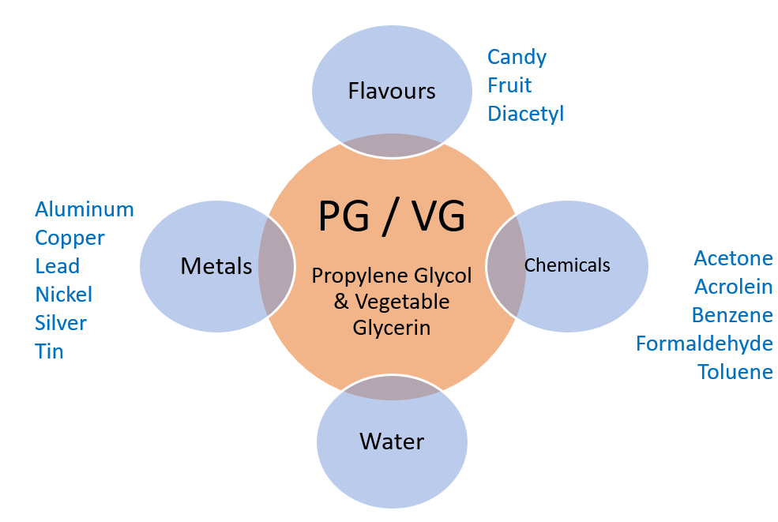
What else is in e-juice/e-liquid?
Notes:
Speaking Notes:
So what else is in that e-juice? There are a lot of things in there that don’t belong in your lungs….Things like
PG and VG – These are the main chemicals in e-juice and they are used to make the vapor cloud (Note to Teacher: PG = propylene glycol and VG = vegetable glycerin)
Heavy Metals –Not of the rock band variety –lol but things like aluminum (soda cans) Copper ( not an old-timey policeman-lol) , Lead (like in bullets), Nickel (like in batteries) Silver, and Tin
Artificial flavours -There are 1000’s of artificial flavours including candy, fruit, mint, chocolate to name a few. Diacetyl {pronounced Die-ASSA –til ) is a creamy or buttery flavouring.
E-Juice also contains a lot of the same chemicals and other ingredients found in tobacco cigarettes. Things like acetone (Nail Polish Remover); Acrolein (A poison made when PG is heated up), Benzene (found in volcanoes and explosives) and Formaldehyde (used to preserve dead things in biology lab and mummies), Toluene (a paint thinner) and many more compounds that are even harder to pronounce (For the teacher, ethylbenzene,, fluorine, rubidium….)
Extra Notes for Teachers:
The vaping industry often makes claims that these products are safe because
a) The Flavours are approved by Health Canada to be safe – but that’s safe to eat; not to inhale in your lungs.
b) they contain smaller amounts of the chemicals also found in tobacco cigarettes. But the truth is we don’t know what amount is safe.. Just because there is less of a chemical does not mean it’s safe to take it into our bodies.
Some youth use a process known as “dripping” – instead of having the coil warm the e-liquid tank, they directly drip drops of juice right onto the hot coil – this creates a thicker vapor cloud and a stronger taste. It’s a dangerous practice because it heats the e-liquid to a higher temperature than normal and in so doing creates even more chemicals. For instance, it increases the conversion of PG to formaldehyde (a carcinogen) The amount of formaldehyde created from dripping is about 15x that found in a tobacco cigarette.

Slide 12
FACT or FICTION?
“ Most e-cigarettes/e-liquids
also contain nicotine.”
Notes:
Speaking Notes:
It’s time for another fact or fiction…
Are there other chemicals in that e-liquid besides the ones we’ve already talked about?
How about nicotine?
Do most vaping products contain nicotine? What do you think? Is this statement fact or fiction?

Slide 13
FACT
Most e-cigarettes/e-liquids contain nicotine!
Even e-liquids that say they “do not” have nicotine or that say they “may or may not” have nicotine have been found to have nicotine in them!
Some products such as Juul use a special type of nicotine called a nicotine “salt”
  Nicotine salts are used to increase the amount of nicotine that gets to your brain.
Notes:
Speaking Notes:
This is a fact…almost all vapes/e-liquids contain nicotine – even the ones that say they don’t on the label may contain it.
So it’s really hard to be sure sometimes if you’re getting nicotine or not and harder still to tell how much you are getting…because it depends on how much nicotine is in there, what type of nicotine it is and how often you vape.
Extra Notes for the Teacher:
Most vapes use something called Freebase Nicotine
Freebase nicotine is the nicotine traditionally used in eLiquids. Freebase nicotine has been treated to remove its particle charge.
Tobacco Giant Phillip Morris found if you remove the positive charge of nicotine, it will return to a free state, this will allow it to travel much more easily across membranes in our bodies. This means more nicotine will make it to the user’s bloodstream and to the brain, making it a more potent form.
Products like JUUL use something even more powerful than freebase nicotine; they use nicotine salts
The terms nicotine salts, nic salt, salt nic, or salt nicotine all mean the same thing. No, it is not the salt you put in your food, and it does not mean it will make your e-liquid salty.
Nicotine salts are created by combining freebase nicotine with an acid, usually Benzoic Acid. This method makes the nicotine taste smoother and drastically increases its absorption into the brain.

Slide 14
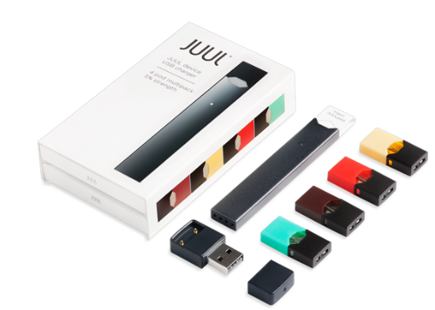

FACT or FICTION?
“One JUUL Pod (5%) contains as much nicotine as 2 packs of tobacco cigarettes.”
=
Notes:
Speaking Notes:
JUUL is a popular brand of e-cigarette used by youth. It looks like a flash drive (or USB stick) . It comes with little pods (such as red pod with the black tip depicted in the slide) . The pods are prefilled with nicotine salt containing e-liquid. They snap into the device for use.
Now that we all know what a JUUL is, is the statement fact or fiction ? How much nicotine is in that pod?
Extra Notes for the Teacher:
The green pod is mint, the yellow is banana flavor etc.

Slide 15
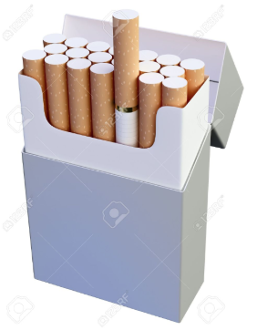

FACT
One 5% nicotine POD of JUUL® contains 41 mg of nicotine
On average a smoker gets 1 mg of nicotine from a tobacco cigarette
So that’s about 40 cigarettes worth of nicotine
There are 20 cigarettes in a pack; so that’s 2 packs!
=
+
Notes:
Speaking Notes:
A pod can last anywhere from a day to a week (in some cases longer)…depending on how much you vape.
If you are vaping a pod a day, that’s like smoking 2 packs of cigarettes.
If a pod lasts you 2 days, that’s like smoking a pack of cigarettes per day.
Extra notes for the Teacher:
One JUUL Pod of 5% nicotine salt contains 59 mg nicotine per ml of liquid
The POD contains 0.7 mls of liquid ( 0.7 mls x 59mg/ml = 41.3 ) That’s 41.3 mg nicotine in a pod!
On average, a smoker’s brain gets about 20 mg of nicotine from a pack of 20 cigarettes (or about 1 mg nicotine per cig smoked)
So 1 JUUL pod has the same amount of nicotine as 2 packs of cigarettes
Many times it can be really hard to tell how much nicotine is in your e-liquid and even harder to tell how much nicotine gets into your brain …because it depends on much nicotine is in your vape and how often you are vaping.

Slide 16
FACT or FICTION?
“E-cigarettes like JUUL or VYPE that contain nicotine salts are safer for youth.”
Notes:
Speaking Notes:
Let’s try another Fact or Fiction…

Slide 17
FICTION
They are designed to make them easier for youth to use and to maximize their exposure to nicotine
They are made to look “techy” or cool
They are made to be easier to hide
They are relatively cheap
They contain nicotine salts which
  Makes the flavours taste better
  Makes them less harsh on your throat-easier for youth
But they also deliver a lot more nicotine…increasing the chances of becoming addicted!
Notes:
Speaking Notes:
Products like JUUL and VYPE are designed to attract youth and hook them on nicotine….and here’s why…(bulleted points in slide)
Extra Notes for the Teacher:
Re easy to hide - They even come with USB chargers so you can plug them into your laptop to charge and mom and dad just think it’s a USB charger.
Up until recent changes in Canadian federal legislation (Spring 2019), these products were marketed towards youth – showing videos and pictures of young people doing fun things and vaping.
A JUUL starter pack which includes 4 pods is $64; Vype is cheaper – and you can get coupons/discount offers on line. So they are cheaper than cigarettes
The nicotine salt formulation makes these products milder on the throat and tastier,…that means youth are more likely to use them!
BUT they also pack more nicotine increasing the chances that youth will get addicted to them and not be able to stop using them.
JUUL has among the highest nicotine content of all e-cigs on the market
If asked: SIGNS of nicotine withdrawal include – dizziness, headache, upset stomach, irritability, restlessness, insomnia, depression, tiredness, difficulty concentrating and bad cravings – most people can’t tolerate these symptoms and go back to vaping within 24-28 hours.

Slide 18
FACT or FICTION?
“Nicotine is the most addictive drug
in society.
You can become addicted to it in
as little as 24 hours.”
Notes:
Speaking Notes:
Tell me if this statement is Fact or Fiction

Slide 19
FACT
Nicotine is a highly addictive drug.
You can become hooked on nicotine really quickly, even after using it just once.
Notes:
Speaking Notes:
Nicotine is the reason why so many tobacco cigarette smokers have difficulty quitting.
It works on the same part of your brain that other addictive drugs do – like opiates (heroin, morphine), cocaine, alcohol, cannabis etc – to cause strong feelings of pleasure or make you feel good. But then your body decides it can’t feel good without it and craves more and more.
More than 1/3 of people who try nicotine just once, become addicted to it.

Slide 20
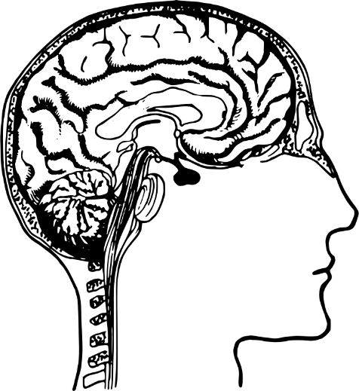
FACT or FICTION?
“Using nicotine before the age of 25
can harm your brain
because it’s still developing.”
Notes:
Speaking Notes:
What do you think, is this statement Fact or Fiction?

Slide 21
FACT
Nicotine damages the developing adolescent brain
Nicotine can harm the part of the brain that controls:
  Learning
    attention and concentration
    memory
    learning and problem solving
  Mood
  Stress ☹︎☹️
☹️
😬
Notes:
Speaking Notes:
Teenagers brains are still growing and will continue to grow until a person is about 25 years old.
The brain is the last part of your body to finish growing.
Nicotine can interfere with brain development causing problems with:
Learning (attention, concentration, memory and problem solving can be impaired)
Mood (can make you feel sad or down especially if you try to stop using it)
Stress (nicotine doesn’t reduce stress. It is a stimulant and can make the stress you already have feel worse)

Slide 22
FACT or FICTION?
“Nicotine is a poison that can be
harmful or fatal
if absorbed through the skin or swallowed.”
Notes:
Speaking Notes:
Nicotine is a poison that can harm or kill you if it is absorbed through the skin or accidentally swallowed…
What do you think? Is this fact or is it fiction?

Slide 23
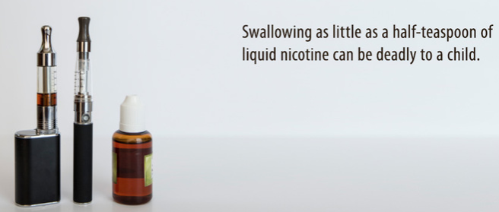
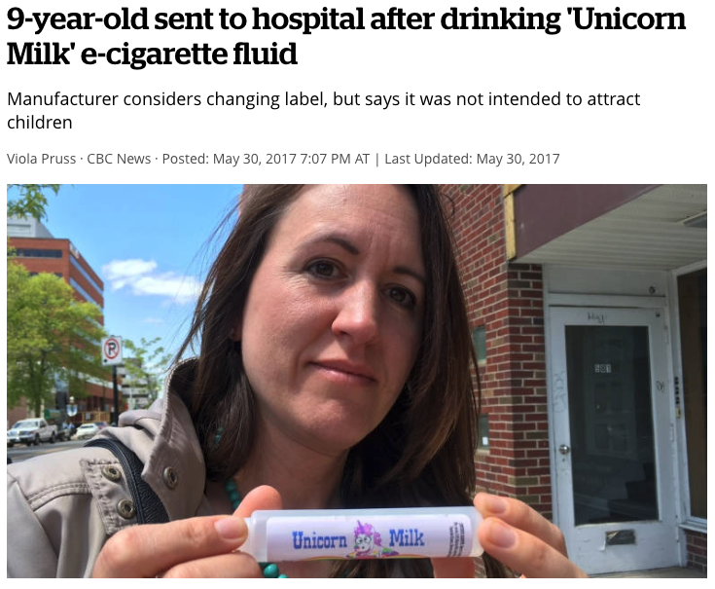
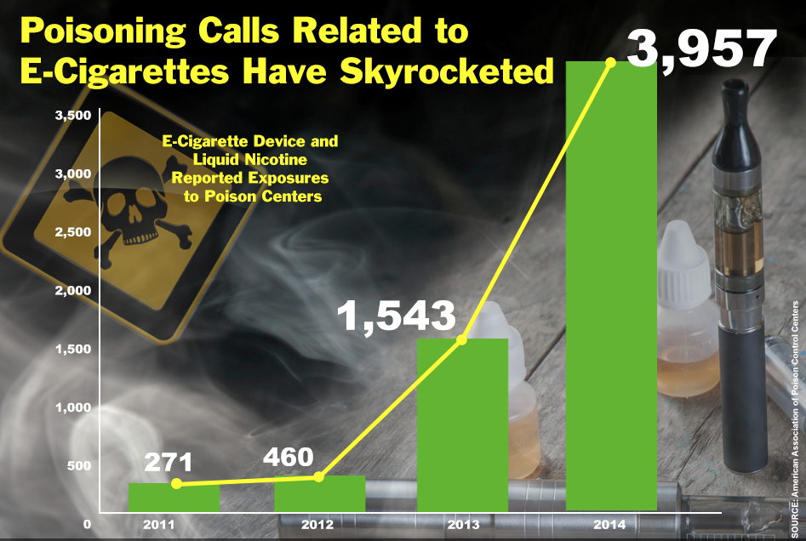
FACT
Notes:
Speaking Notes:
This is a fact! Nicotine is a poison. And if spilled on your skin or accidentally swallowed it can cause nicotine poisoning. As little as a half teaspoon of nicotine liquid (used to make e-juice) can kill a child.
Extra Notes for the Teacher:
Most poisonings are the result of accidental ingestion (candy flavoured e-juice with appealing names make them tempting to little brother or sister (see CBC news caption on left re 9 year old…found bottle on Unicorn Milk on playground and drank it)
Since the introduction of vapes around 2011 and their increasing popularity, the rate of calls related to nicotine poisoning from vaping to poison control centres has increased dramatically. See bar graph depicting increase in calls to poison control centres (Note this is US data – Canada does not maintain a central database making it difficult to gather this information).
More than half of all poisonings were in children under 6 years of age.
Some poisonings were also the result of individuals having their vapes in bed with them and rolling on them in the night, causing the tank to break and the nicotine in the e-liquid to be absorbed into their skin, or from ”home brewers” (people who buy nicotine and other e-liquid ingredients on-line and make e-juice and sell it illegally) who spill it when measuring out nicotine.
What does Nicotine Toxicity look like If asked…signs of nicotine toxicity include: dizziness, nausea, diarrhea, irregular and/or rapid heartbeat, difficulty breathing, seizures…death. Poisoning usually a bigger problem if absorbed through the skin versus swallowed because there are nicotine receptors in your stomach which when stimulated by nicotine ingestion, cause you to vomit.

Slide 24
FACT or FICTION?
“Youth who use e-cigarettes are LESS likely to smoke tobacco cigarettes later in life.”
Notes:
Speaking Notes:
What do folks think…is this fact or fiction?

Slide 25
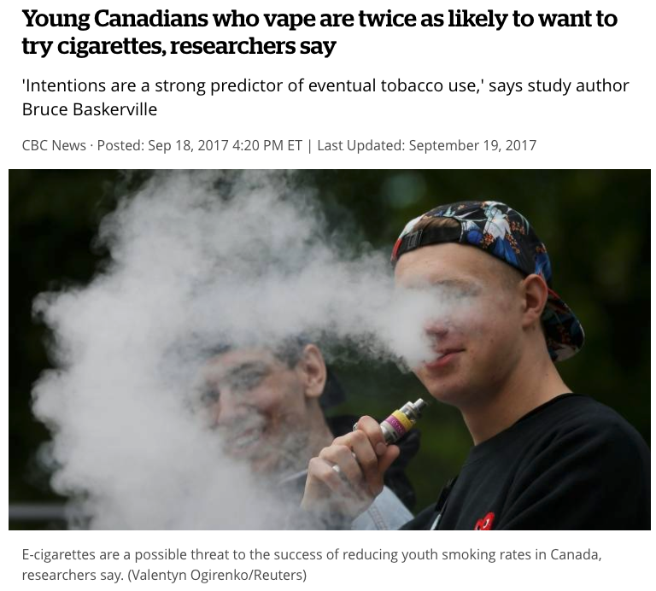
FICTION
A number of studies have shown that youth who use vapes are MORE likely to smoke regular tobacco cigarettes in the future
Nicotine can prime the adolescent brain for addiction to other substances
Notes:
Speaking Notes:
It’s fiction.
There are a number of studies out there reporting that youth who vape are between 2-7x more likely to smoke tobacco Cigarettes in the future.
Nicotine, whether it comes from vaping or from smoking a tobacco cigarette, works in your brain to create new pathways of addiction.
Extra Notes for the Teacher:
Why is vaping associated with a risk for smoking later on ? We don’t really know for sure…there could be a number of factors at play such as…
The nicotine itself – changes the brain and makes it more vulnerable to addictive substances
Nicotine can also change the brain in such a way as to make youth more impulsive or more likely to try risky things…like smoking.
Youth who vape often do so in the same place as youth who smoke cigarettes – so they are exposed to cigarettes
All this vaping and smoking (especially on TV/Netflix/Social Media) is normalizing smoking – it must be okay if so many people are doing it…right?

Slide 26
FACT or FICTION?
“ The flavourings used in e-cigarettes
are safe to inhale.”
Notes:
Speaking Notes:
OK so what does everyone think about this statement ….is that candy or fruit or mint flavour in the e-liquid doing us any harm when we vape?

Slide 27

FICTION
Safe to eat does not mean they are safe to breathe in!
Chemicals are often used to make the flavours in e-liquids for example:
  Diacetyl – makes a buttery or creamy flavour
  Vanillin and ethylvanillin - vanilla flavor
  Cinnamaldehyde – cinnamon flavor
Diacetyl causes a chronic, severe lung disease – called popcorn lung!
Vanilla flavours damage your throat and lungs causing chronic cough, mouth ulcers, and gum disease.
Cinnamon flavours suppress your immune system and make you more likely to get lung infections like pneumonia.
Notes:
Speaking Notes:
That one is FICTION …
Many flavourings are approved by Health Canada as being safe…but that’s referring to their safety for ingestion/eating; not inhaling.
Some vape retailers make a point of saying their flavours are safe for consumption – but they are misinterpreting what Health Canada is saying.
The chemicals used to make these flavours can actually hurt your lungs and cause things like chronic cough, shortness of breath or difficulty breathing, and lung infections. And maybe lung cancers – e-cigarettes haven’t been around long enough yet for us to know.
Extra Notes for the Teacher:
In fact we know for sure that some flavours are definitely not safe and can cause throat irritation, chronic cough, shortness of breath (this is becoming a problem in athletes who vape), as well as cause/worsen asthma and COPD(emphysema)
Diacetyl is big concern, This is a chemical used to produce a butter flavor. It is added to microwave popcorn. When inhaled (by workers in the popcorn plants) it caused a severe, irreversible form of emphysema known as bronchiolitis obliterans (it obliterated the air sacs/alveoli in the lungs). It was nicknamed “Popcorn Lung”. It’s fatal –unless you can receive a lung transplant.
Vanilla, cinnamon, butter/cream, and clove flavours should definitely be avoided because they are proven to damage your respiratory tract.

Slide 28
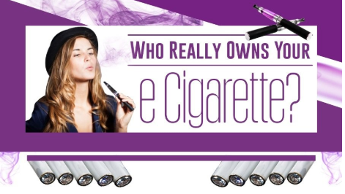
FACT or FICTION?
“The tobacco industry owns most of the
e-cigarette companies.”
Notes:
Speaking Notes:
Do you think this one is fact or fiction?

Slide 29
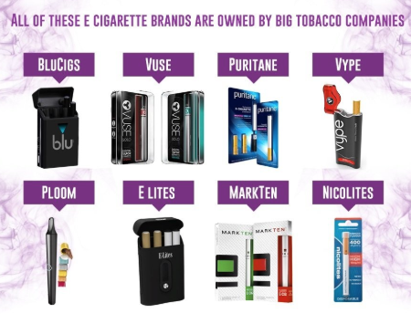
FACT
Big tobacco companies own most of the vape companies
They target youth by:
  Adding candy and fruit flavours
  Making vapes that look cool
  Using advertisements that make vaping seem fun and safe
  Offering sales on their products
Philip Morris (Marlboro) owns 35% of JUUL
They add nicotine because they want you to be addicted and be their customer for life!
They don’t care about you; they want to make money for their shareholders
Notes:
Speaking Notes:
It’s a fact. The big tobacco companies own almost all of the vaping products now.
Big Tobacco is not interested in anyone’s health. They want to get people hooked on nicotine as young as possible – to create a customer for life. They are a big business and they are accountable to their shareholders, not to you. Don’t be taken in.
Extra Notes for the Teacher:
When JUUL first came out, it actually said “Big Tobacco is our Enemy”
Then in 2018, JUUL sold 35% of its company to Tobacco Giant, Altria ( formerly known as Philip Morris – most famous for the Marlboro Man – an actor who portrayed a cowboy who smoked Marlboro cigs (and who died of lung cancer) for $12.8 billion dollars – cash.

Slide 30
FACT or FICTION?
“By law, store owners in Newfoundland and Labrador cannot sell e-cigarettes or a vaping product to individuals under the age of 19”
Notes:
Speaking Notes:
How about this one…is it fact or fiction ?
Extra Notes for the Teacher:
A vaping product could be an e-cigarette itself or any product used in an e-cigarette such as e-juice or pods

Slide 31
FACT
In NL it is illegal to sell an e-cigarette or vaping product to anyone under the age of 19
Notes:
Speaking Notes:
This is a fact
NL regulates the sale of vapes and related products under the Provincial Tobacco and Vapour Products Control Act.
It regulates them the same as tobacco products…
The Smoke-Free Environment Act, 2005 and the NL English School District Smoke-Free Policy prohibit the use of vaping products in schools with the school policy also prohibiting use on school grounds. Vaping products are treated the same way as tobacco products.
Extra Notes for the Teacher:
The ACT:
Makes it an offence for a retailer or other person (family, friends) to sell, give or furnish, directly or indirectly, tobacco, vapour products or non-tobacco shisha product to a minor – under the age of 19. (This is an important point because we know one of the most common source for e-cigarettes is friends)
Aims to reduce the number of young people who begin to smoke by restricting youth access to tobacco, vapor and non-tobacco shisha products,
Restricts how tobacco, vapor and non-tobacco shisha products can be displayed, stored and promoted at retail (Tobacco and Vapour Products Control Regulations)
Limits the type and number of establishments that sell tobacco, vapor and non-tobacco shisha
The Smoke-Free Environment Act, 2005 and the NL English School District Smoke-Free Policy prohibit the use of vaping products in schools with the school policy also prohibiting use on school grounds. Vaping products are treated the same way as tobacco products.
For teachers: It might be interesting to ask the class what their thoughts are on how easy it is to get e-cigarettes under 19 years of age

Slide 32
FACT or FICTION?
“Some e-cigarettes are safe for youth”
Notes:
Speaking Notes:
Ok, now we are back to our original question…what do you think?
Has this presentation made you think a bit more or changed your thinking about these products ?

Slide 33
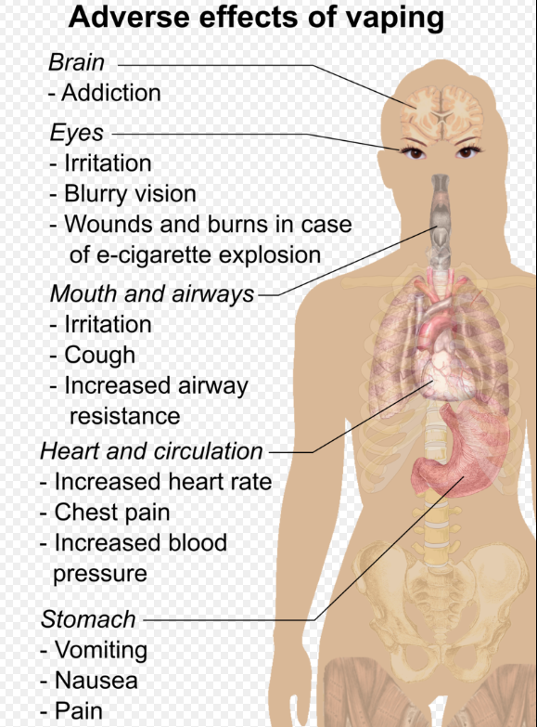
FICTION
E-cigarettes are not safe for youth
Nicotine addiction & poisonings
Throat irritation & chronic cough
Lung disease
Heart disease
Battery explosions & severe burns
We won’t know what all the long-term health effects are for a number of years!
Notes:
Speaking Notes:
As noted throughout this presentation, Vaping is not harmless.
E-cigarettes are not safe for youth, young adults or anyone who do not currently use tobacco products.
Extra Notes for the Teacher:
E-cigarettes contain nicotine. Nicotine is a highly addictive substance. Vaping can lead to nicotine addiction.
Other Harms
Due to nicotine content, e-liquids are dangerous to small children and pets if swallowed or spilled on the skin.
Defective e-cigarette batteries have caused fires and explosions, some of which have resulted in serious injuries.
Other chemicals including flavourings and heavy metals are also concerning.
The long term consequences of vaping are unknown. Additional research is needed to help understand long-term health effects of e-cigarette use. What will several years or decades of use cause?
We are just starting to understand what the long term health consequences may be

Slide 34
If they are not safe, why is it okay for adults to vape?
Vaping is not safe for anyone, but it is especially not safe for youth.
Here’s when we think vaping might be okay for some adults…
  Vaping may help some adults who smoke tobacco cigarettes quit. We don’t have a lot of evidence yet.
  For adults who just cannot quit smoking, switching to vaping may be a form of harm reduction-it is likely safer than smoking; but not completely safe
If you do not smoke tobacco cigarettes, do not vape…no matter how old you are!
Notes:
Speaking Notes:
E-cigarettes are just Not Safe for youth…
Can lead to a lifetime of nicotine addiction…damage your brain and increase the likelihood of picking up smoking tobacco cigarettes and cause accidental poisonings
Can damage your lungs and heart
Battery explosions from e-cigarettes have caused serious injury due to burns, and death.
For Adults:
Right now, e-cigarettes are not approved as a method to quit smoking. But we know that they have helped some smokers to quit.
However a lot of smokers who initially switch to vapes end up using both vapes and tobacco cigarettes – this does nothing to reduce their risk of premature disease and death
And even though vapes have been around since 2011, the rate of tobacco smoking in Canada has not gone down, in fact it went up in 2017 (including in youth)
IF you are an adult and you think you will never quit, switching over completely to vaping MAY be safer than continuing to smoke tobacco cigarettes…but SAFER DOES NOT MEAN SAFE
VAPING IS NOT HARMLESS
Anyone who is NOT a smoker, should never vape!

Slide 35

WHATEVER YOU CALL THEM,
DON’T CALL THEM SAFE
ELECTRONIC CIGARETTES, E-CIGS, VAPES, VAPORIZERS – WHATEVER YOU CALL THEM DOESN’T MATTER. WHAT DOES MATTER IS THAT THEY FILL YOUR LUNGS WITH THINGS THAT SHOULDN’T BE THERE
.
Notes:
Speaking Notes:
The truth is…e-cigarettes fill your lungs with things that shouldn’t be there!
The only way to be safe is to NOT vape or smoke

Slide 36
Consider the Consequences of vaping…
Consider the consequences of vaping 30 second video by Health Canada (also available on Youtube)
https://www.canada.ca/en/services/health/campaigns/vaping.html
Notes:
Note for the Teacher:
This is a link to Health Canada’s video on vaping.
Chrome or Explorer can be used to view the video; trouble with viewing on one platform may necessitate switching to the other.

Slide 37
Other Resources
Some slides in this presentation used information or were adapted from the following:
  Massachusetts Tobacco Cessation and Prevention program: The Get Outraged _ make smoking history campaign http://makesmokinghistory.org/tobacco-targets-kids/getoutraged/
  Centres for Disease Control and Prevention: Know the risks: a youth guide to e-cigarettes. https://www.cdc.gov/tobacco/basic_information/e-cigarettes/youth-guide-to-e-cigarettes-presentation.html
  Health Canada: About vaping https://www.canada.ca/en/health-canada/services/smoking-tobacco/vaping.html?utm_source=google&utm_medium=cpc_en&utm_content=generic_2&utm_campaign=vapingprevention2019&utm_term=vapes
  Health Canada: Consider the Consequences of vaping. https://www.canada.ca/en/services/health/campaigns/vaping.html
  Orange County Department of Education: Notsosafe.org.

Slide 38

Acknowledgements
This presentation was developed by Dr. Leslie Phillips, Professor Memorial University School of Pharmacy and Faculty of Medicine: Discipline of Psychiatry in partnership with The Alliance for the Control of Tobacco’s Youth Tobacco and Vaping Prevention Working Group:
  Department of Education and Early Childhood Development
  Department of Children, Senior’s and Social Development
  The English School District
  Department of Service NL
  Western Health
  Eastern Health
  Federation of School Councils
  Memorial University School of Pharmacy
Any reproduction without the expressed consent of the authors is prohibited.

Slide 39
Please Complete Our Survey
Thank-you for delivering the Youth Vaping Awareness Session. For evaluation purposes, please complete and submit this form with your feedback. Email addresses will not be collected.
https://forms.gle/eHXPSr6yPZvC84ns9

